Slide 1
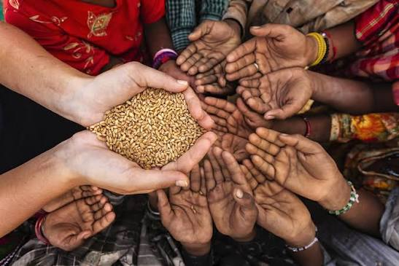
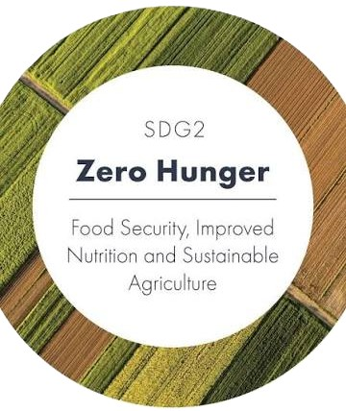
Zero Hunger: Digital Food-Aid Supply Chain Platform
UN Sustainable Development Goal 2 (Zero Hunger)
Bridging the Gap Between Surplus Food and Community Need
Presenter Name: Sandip Maity
College Name: Adamas University

Slide 2
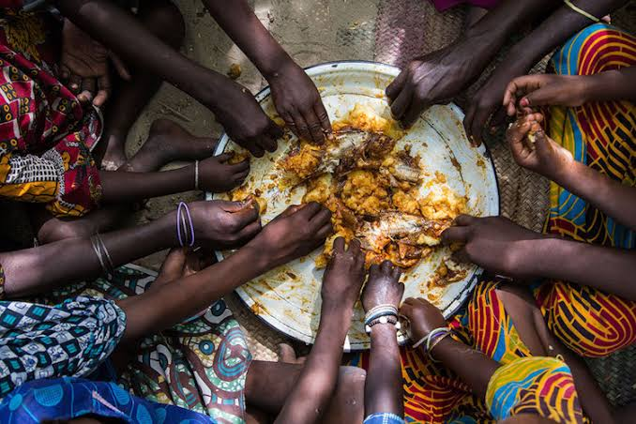

Problem Statement & Motivation
Food Insecurity Is Primarily A Coordination Failure Where Surplus Food Goes To Waste While Vulnerable Communities Lack A Unified Digital Tracking System To Bridge The Gap.
KEY CHALLENGES:
Massive surplus food goes to waste daily in restaurants, events, and corporate canteens.
Vulnerable communities and shelters struggle with food insecurity due to lack of real-time visibility.
Fragmented communication (phone calls, ad-hoc messaging) leads to logistical breakdowns and delayed pickups.
OBJECTIVE: Build a unified, transparent, and scalable digital platform to streamline food rescue operations.

Slide 3
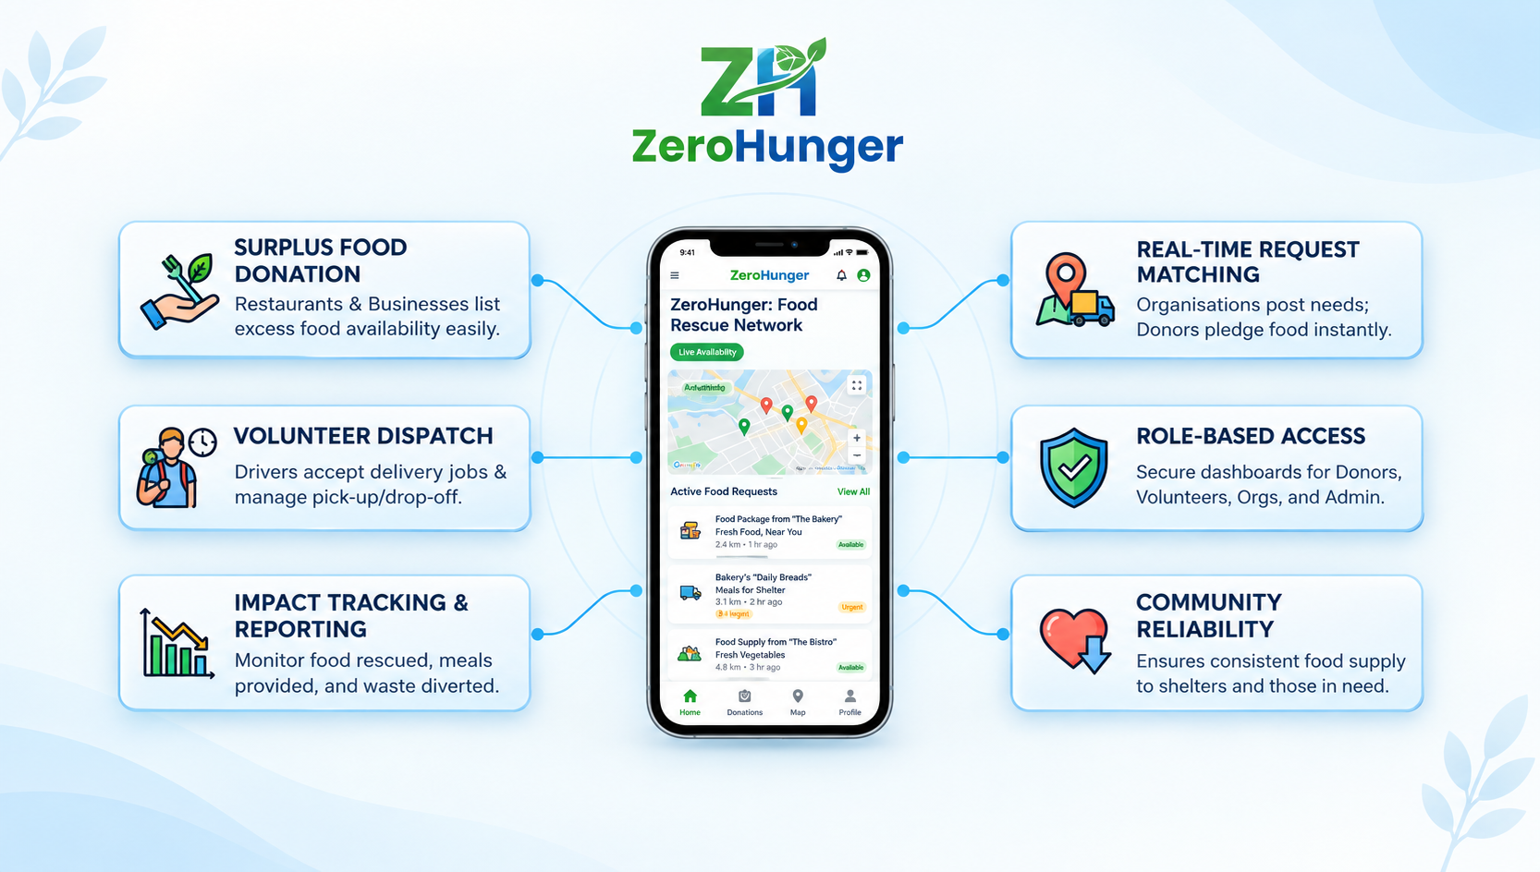
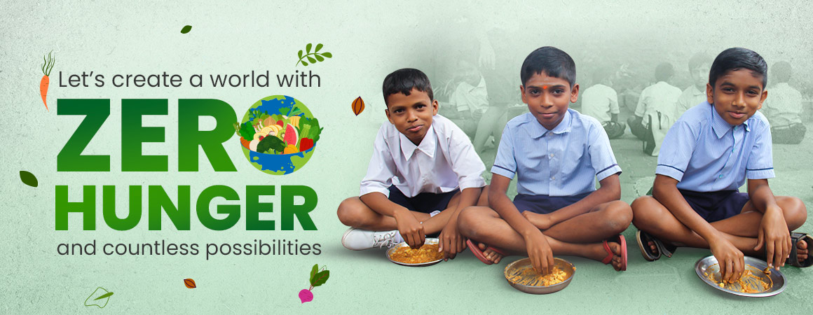
Solution Overview & Features
A Full-stack Web Application That Digitizes The Entire Food-aid Supply Chain, Connecting Surplus Food Sources With Communities That Need It Most.
Core Features:
Role-Based Access Control (RBAC): Customized dashboards for Organizers, Donors, Volunteers, and Admins.
Real-Time Request Matching: Instant posting and browsing of food-aid requirements with headcount and location data.
End-to-End Tracking: Live tracking of donation status from pledge to final delivery.
Audit & Management: Admin tools for user verification, account management, and system integrity.

Slide 4
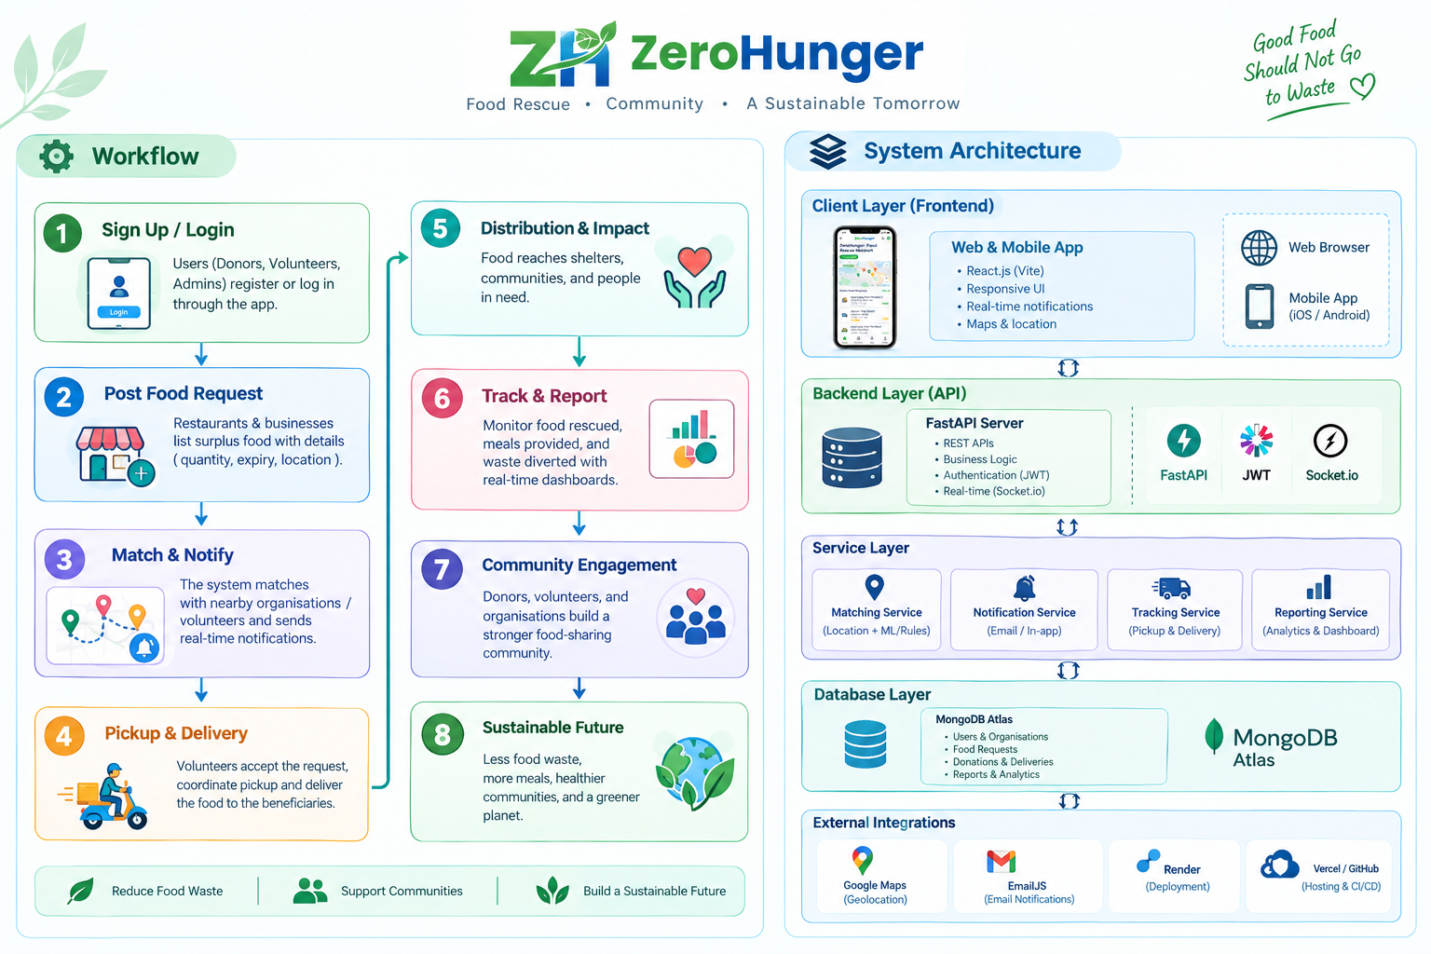

Workflows & System Architecture
Organisations (Shelters, Pantries, NGOs):Post food-aid requests with headcount, location, and date needs.
Donors (Restaurants, Businesses, Individuals): Browse requests, pledge surplus food, and choose delivery methods.
Volunteers (Couriers, Drivers): Accept delivery jobs, manage pickups, and coordinate drop-offs.
Admins (Platform Managers):Oversee registrations, audit system activity, and ensure compliance
Technology Stack: Built using React.js, Tailwind CSS, Node.js, Express.js, and MongoDB

Slide 5
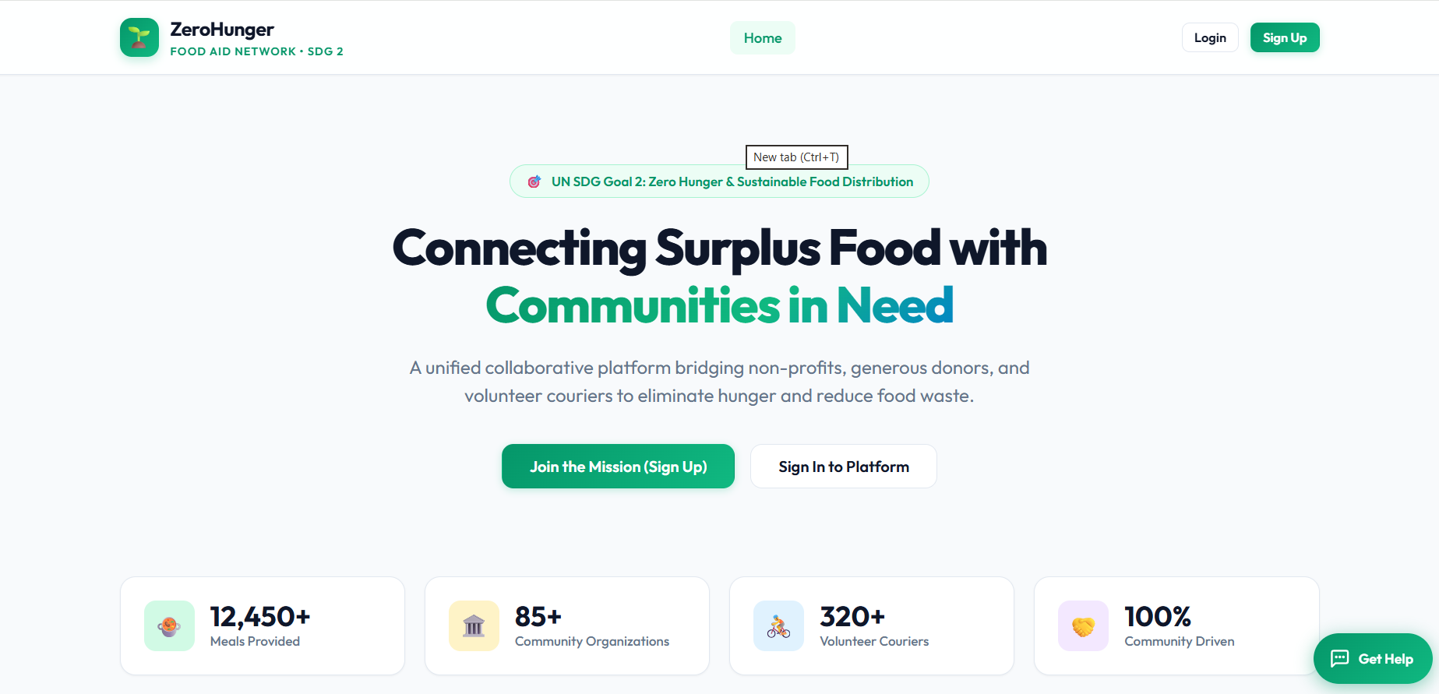
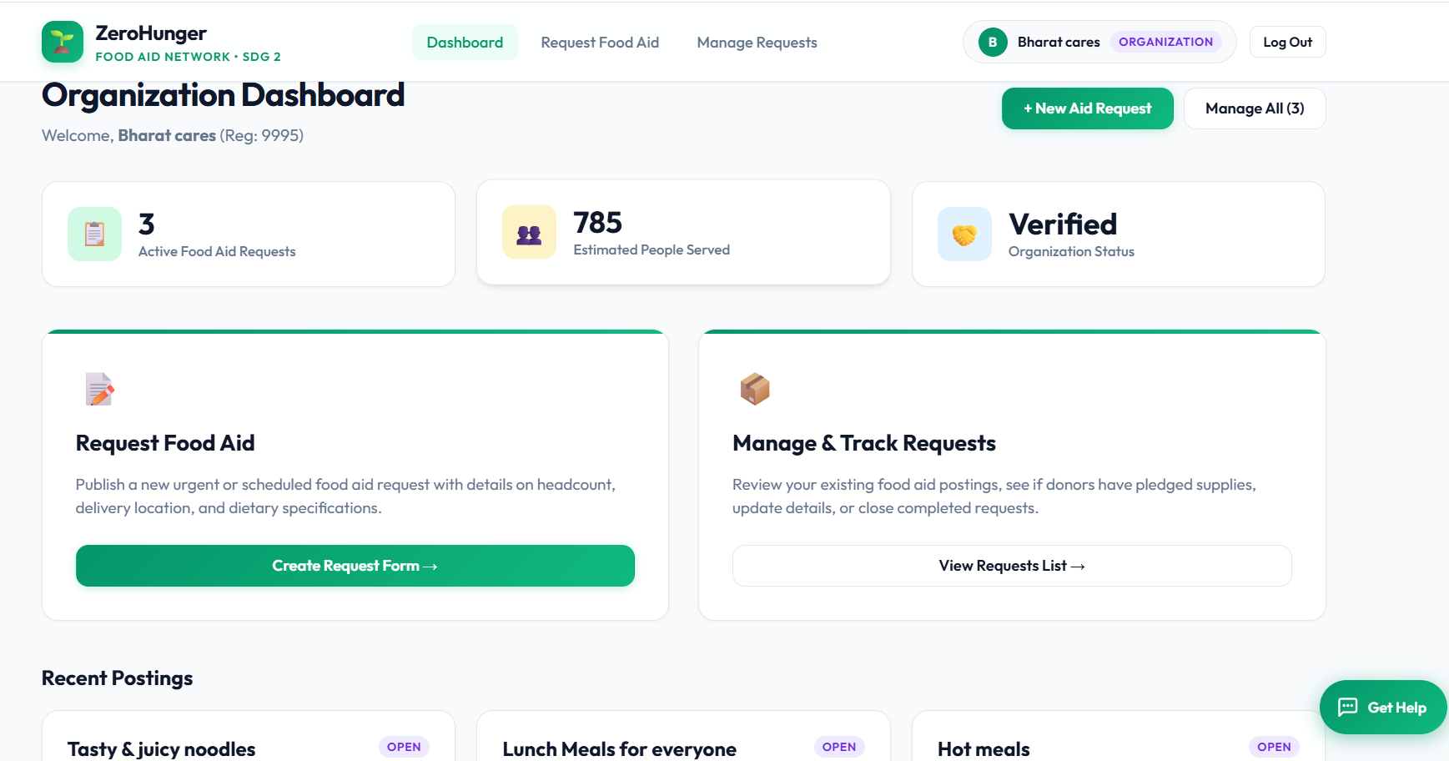
Feasibility & Viability Analysis
Technical Feasibility: Built using industry-standard web tech (MERN stack), ensuring high modularity, easy local debugging, and smooth cloud deployment capabilities (Vercel + Render).
Economic Viability: Low-cost infrastructure utilizing modern cloud tiers, open-source libraries, and serverless/containerized hosting.
Operational Feasibility: Intuitive UI/UX design reduces the learning curve for non-technical volunteers and community shelter managers.
Solution(video): Link

Slide 6
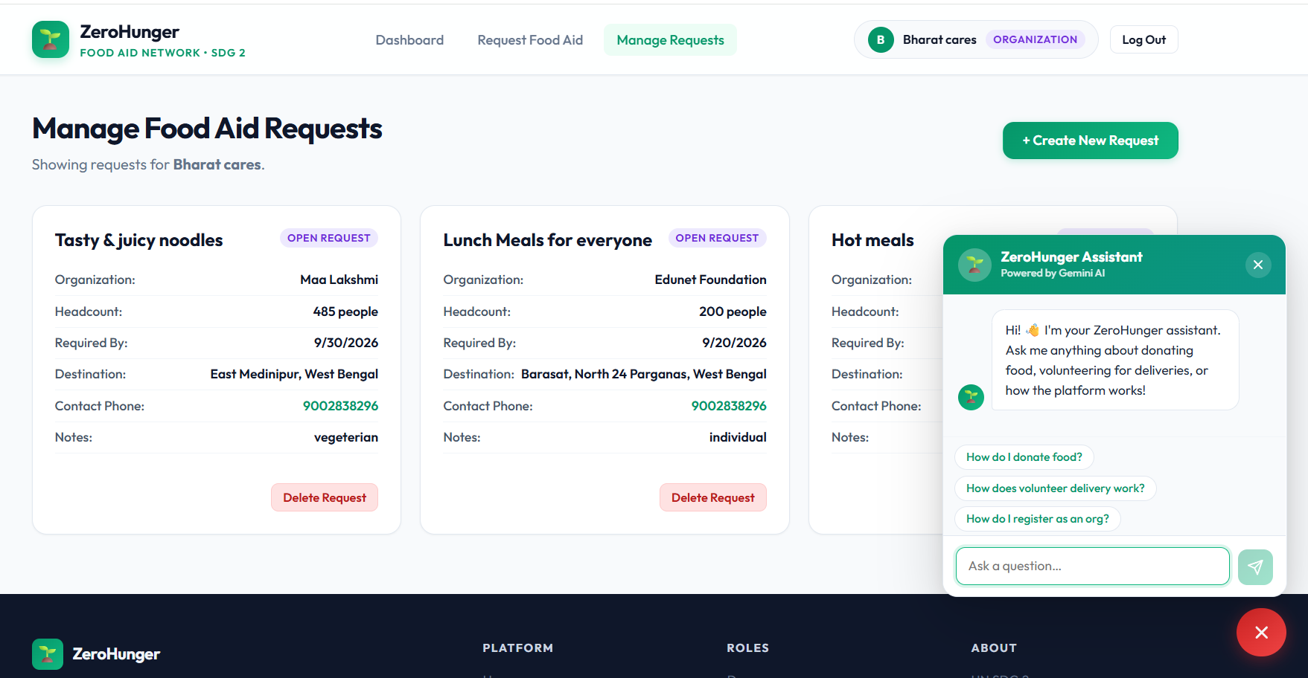
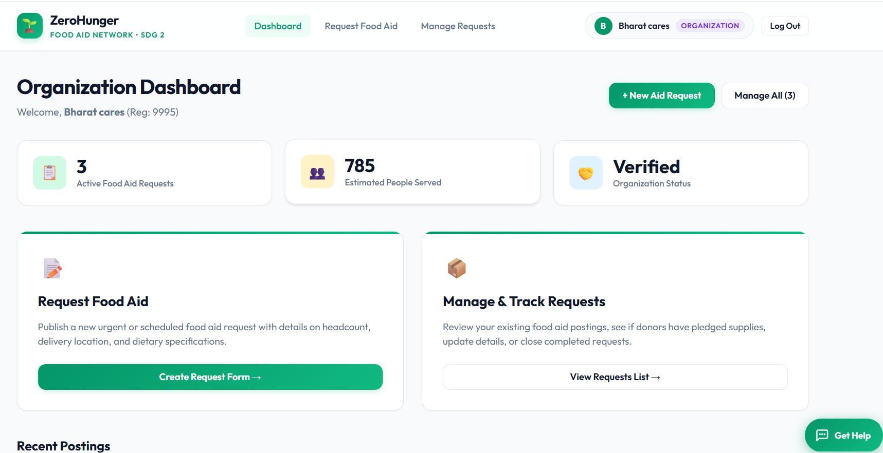

Impact Statement & Societal Benefits
Quantifiable Social & Environmental Shifts:
For Hungry Communities: Reliable, consistent, and safe access to daily nutrition.
For Food Businesses: Reduced waste disposal costs and streamlined Corporate Social Responsibility (CSR) compliance.
For Volunteers: A structured, trackable, and gamified way to contribute to society.
For Society: Lower organic waste in landfills, directly cutting down greenhouse gas (methane) emissions.

Slide 7
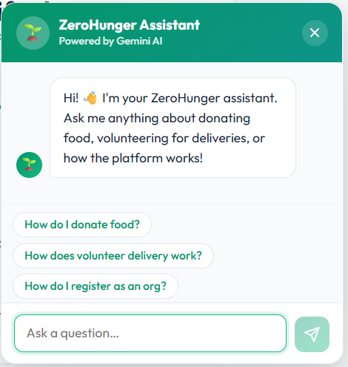

Future Scope & Scalability
Advanced AI Integration:
Predictive demand forecasting to anticipate food surpluses in specific neighborhoods using historical data.
Smart route optimization algorithms for volunteers to minimize transit time and fuel consumption.
Platform Expansion:
Mobile application wrapper (React Native) for push notifications and GPS tracking.
Integration with local municipal food waste management systems.

Slide 8
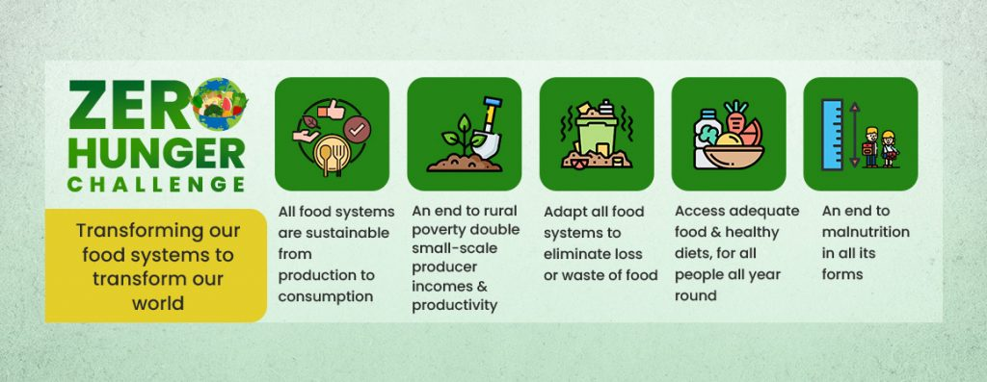
Conclusion & Research Reference
Summary:
ZeroHunger bridges the gap between digital innovation and social good, turning logistical chaos into an organized ecosystem.
Key Takeaway for Students:
Think critically about real-world friction.
Apply scalable software design with purpose.
Build technology that creates measurable human impact.
References & Research Work:
UN Sustainable Development Goals (SDG 2 Framework) Link
MERN Stack Architectural Patterns & Supply Chain Digitization Research Papers Link
PROJECT(Link)
https://zero-ruby-eight.vercel.app/login
GitHub(Link):
https://github.com/Sandip-Maity-2023/Zero

